Slide 1
Introduction to Quantum Networking

Slide 2
What is Quantum Networking?
A communication network that transmits quantum bits (qubits).
Uses quantum entanglement and teleportation to transfer information.
Enables applications like distributed quantum computing and quantum internet.

Slide 3
Quantum vs Classical Networking
Classical: Sends bits directly; allows copying and amplification.
Quantum: Transfers state using entanglement and teleportation.
Classical routers use store-and-forward; quantum routers use entanglement swapping.

Slide 4
Applications of Quantum Networking
Secure Communication (QKD and quantum internet).
Distributed Quantum Computing.
Quantum-enhanced sensing and timing.
Quantum cloud services.

Slide 5
Quantum Network Background
Quantum Communication
Qubit: Basic unit of quantum information, can be an electron or a photon or a nucleus from an atom. A qubit is described by its state.
Superposition: Qubit can be in multiple states at once.

Slide 6
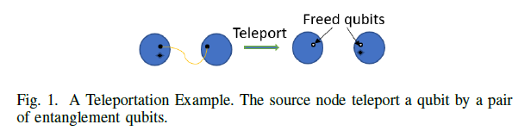
Quantum Network Background
A. Quantum Communication
Entanglement: Correlation between qubits that persists across distance, consisting of offline and online stage.
Teleportation: If a pair of entanglement quibts are shared by two nodes, the secret information can be transmitted from one node to another one with the help of quantum measurement.

Slide 7
Quantum Network Background
B. Quantum network components
Quantum users: demands to entangle with other users.
Quantum switches: relays for entanglement process
Quantum links
The traditional Internet

Slide 8
Multi-Entanglement Routing Design over Quantum Networks
Yiming Zengz, Jiarui Zhangz, Ji Liu, Zhenhua Liu, Yuanyuan Yang (INFOCOM 2022)

Slide 9
Introduction
Entanglement is an essential component of most quantum applications mentioned above.
However, the entanglement process is probabilistic and not stable.
Quantum switches are placed in the network as relays to supply end-to-end entanglements for multiple quantum users

Slide 10
Motivation
The entanglement routing problem about how to build long distance entanglement through quantum switches is crucial.
However, the switch resource (the number of qubits) is the limitation of the quantum network in reality instead of the transmission link capacity.

Slide 11
Objective
we consider a general quantum network structure and present a comprehensive entanglement process for multiple pairs of quantum users.
Our goal is to maximize the number of quantum-user pairs and the expected network throughput at the same time.

Slide 12
Contribution
1. The modeling of the detailed multi-entanglement routing process for multiple quantum-user pairs as the offline and the online stages.
2. The formulation of the problem as two integer linear programming problems that are both NP-Complete.

Slide 13
Contribution
3. The design of the routing protocol by proposing efficient algorithms with lower time complexity and performance guarantees.
4. Evaluation highlight that our approach can improve the number of served quantum-user pairs 85% and the expected throughput 27% in average compared with existing works.

Slide 14
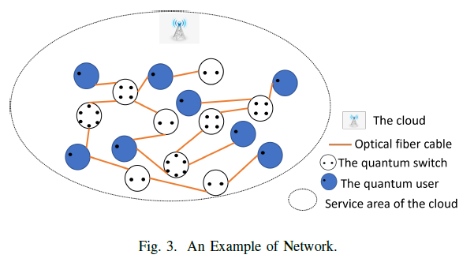
Quantum Network Model

Slide 15
Quantum Network Model
A. Network Model:
Quantum users
Network Graph
Quantum Switch
Quantum Link

Slide 16
Quantum Network Model
B. Routing Matrices:
For a quantum-user pair Network Graph, For a path
Building a quantum channel successful for a quantum-user pair along a path requires all links to generate entanglement and switches to swap successfully during the fixed time period.

Slide 17
Quantum Network Model
C. Problem Formulation:
Objectives are divided into two steps:
STEP I: maximize the quantum-user pairs number that can be served by the network, a main routing path is selected for every chosen quantum-user pair.
STEP II: maximize the expected throughput of all selected quantum-user pairs from STEP I.

Slide 18
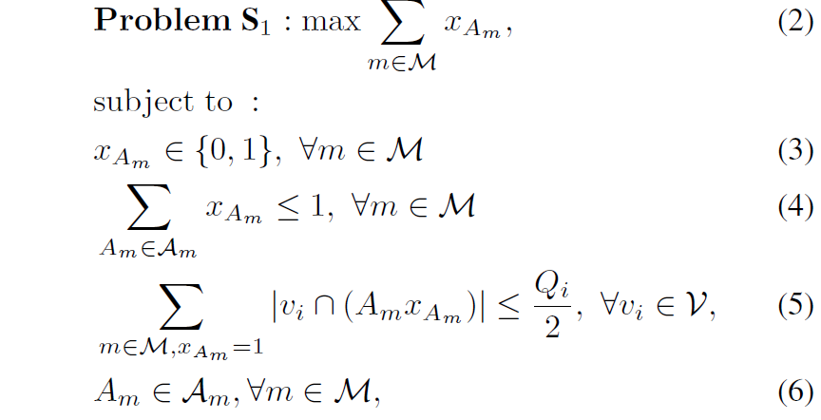
Quantum Network Model
C. Problem Formulation:
STEP I: maximize the quantum-user pairs number that can be served by the network, a main routing path is selected for every chosen quantum-user pair.

Slide 19
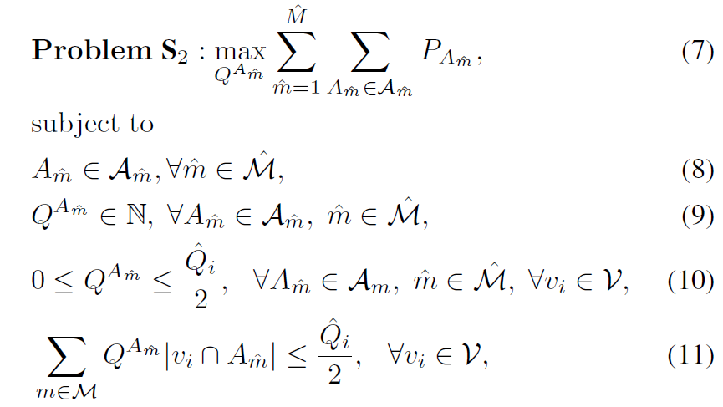
Quantum Network Model
C. Problem Formulation:
STEP II: maximize the expected throughput of all selected quantum-user pairs from STEP I.

Slide 20
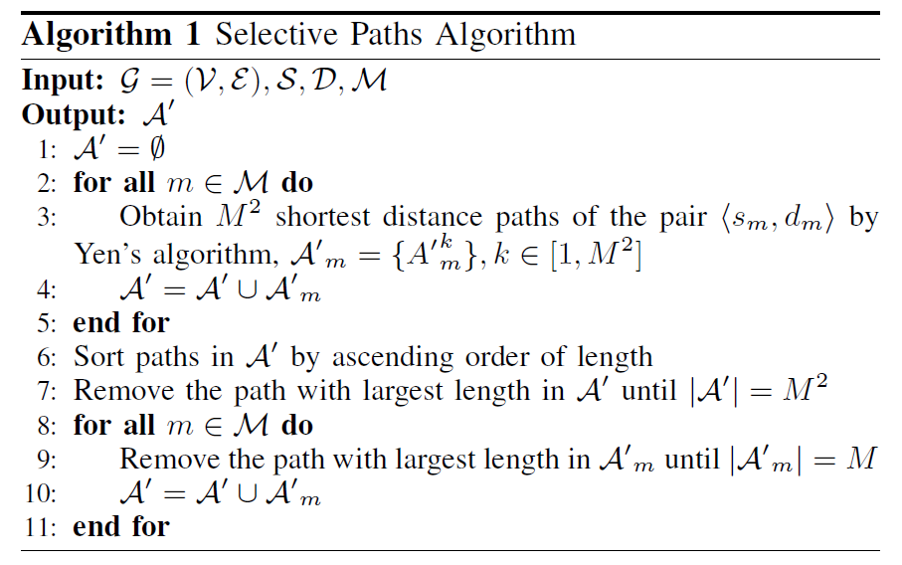
Proposed Solution
A. Problem 1 Complexity: NP-Complete
B. Problem 1 Solution:
Heuristic algorithm: Shortest distance path.

Slide 21
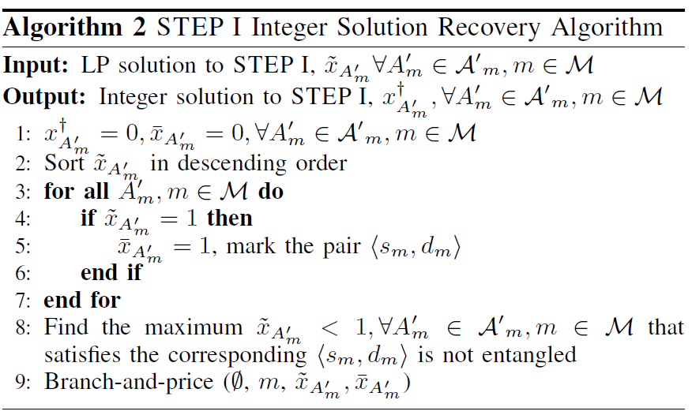
Proposed Solution
A. Problem 1 Complexity: NP-Complete
B. Problem 1 Solution:
Integer solution recovery

Slide 22
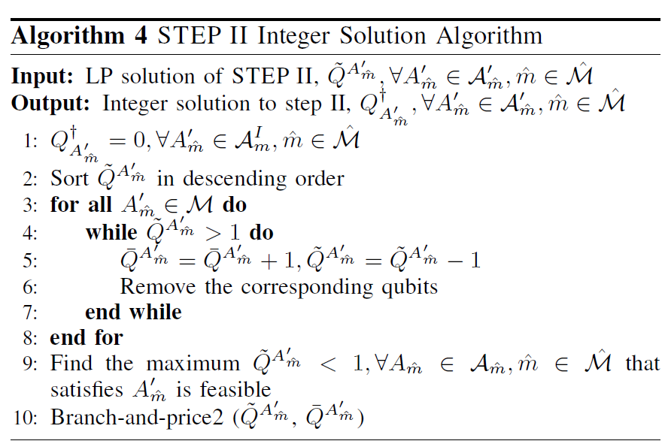
Proposed Solution
A. Problem 2 Complexity: NP-Complete
B. Problem 2 Solution:

Slide 23
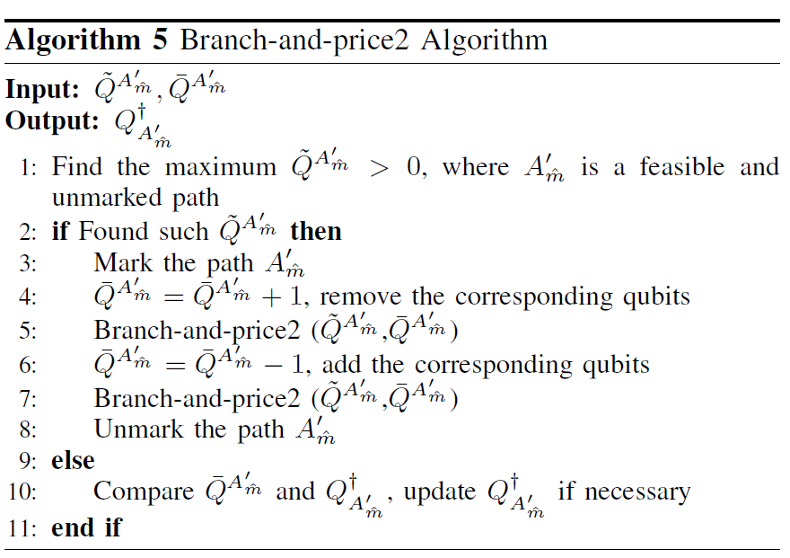
Proposed Solution
A. Problem 2 Complexity: NP-Complete
B. Problem 2 Solution:

Slide 24
Simulation setup
Network Topology: random networks without the fixed topology. ​
Algorithm Benchmarks: ​
ALGORITHM 4
FER
Q-PASS
BASELINE-1(B1)

Slide 25
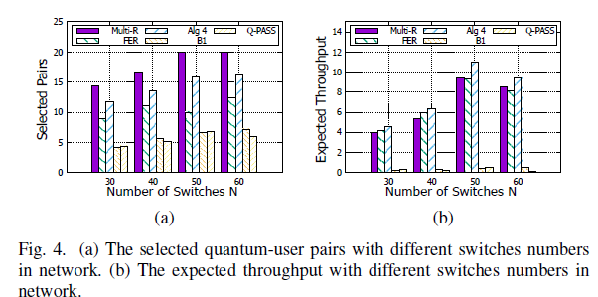
Evaluation result
Number of served quantum-user pairs
Expected Throughput.

Slide 26
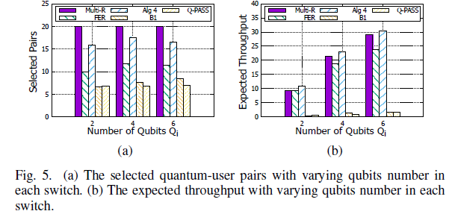
Evaluation result
Number of served quantum-user pairs
Expected Throughput.

Slide 27
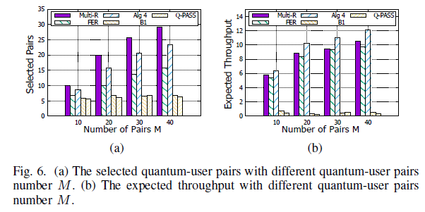
Evaluation result
Impact of the network parameters.
Impact of the quantum-user pairs number.

Slide 28
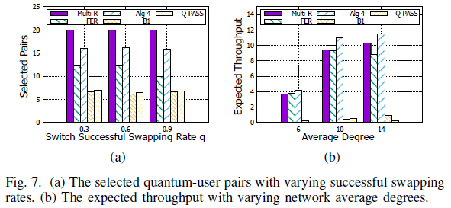
Evaluation result
Impact of the network parameters.
Impact of the quantum-user pairs number.

Slide 29
Conclusion
The paper presents a novel routing protocol for multi-entanglement in quantum networks.
​
The proposed algorithms effectively maximize the number of served quantum-user pairs and expected throughput, outperforming existing methods. ​

